Slide 1


Master of Science (Computer Science) Sub. Code: COMS 411 Sub. Name: Design of Algorithms
Dr. S. RAVI, Dept. of Computer Science

Slide 2
Definition of Algorithm
The word Algorithm comes from the name of the Persian author, Abu Jafar Mohammed ibn Musa al Khowarishmi (c. 825 A.D).
Al-Khowarizmi meaning from the town of Khowarasm, city is now known as Khiva and located in Uzbekistan, USSR.
Algorism – algorithm.
Any special method of solving a certain kind of problem. (Webster’s dictionary)
Algorithm is composed of a finite set of steps, each of which may require one or more operations.

Slide 3
Problem Solving: Main Steps
Problem definition
Algorithm design / Algorithm specification
Algorithm analysis
Implementation
Testing
[Maintenance]

Slide 4
1. Problem Definition
What is the task to be accomplished?
Calculate the average of the grades for a given student
Understand the talks given out by politicians and translate them in Chinese
What are the time / space / speed / performance requirements ?

Slide 5
2. Algorithm Design / Specifications
Algorithm: Finite set of instructions that, if followed, accomplishes a particular task.
Describe: in natural language / pseudo-code / diagrams / etc.
Criteria to follow:
Input: Zero or more quantities (externally produced)
Output: One or more quantities
Definiteness: Clarity, precision of each instruction
Finiteness: The algorithm has to stop after a finite (may be very large) number of steps
Effectiveness: Each instruction has to be basic enough and feasible
Understand speech
Translate to Chinese

Slide 6
Computer Algorithms
An algorithm is a procedure (a finite set of well-defined instructions) for accomplishing some tasks which,
given an initial state
terminate in a defined end-state
The computational complexity and efficient implementation of the algorithm are important in computing, and this depends on suitable data structures.

Slide 7
4,5,6: Implementation, Testing, Maintainance
Implementation
Decide on the programming language to use
C, C++, Lisp, Java, Perl, Prolog, assembly, etc. , etc.
Write clean, well documented code
Test, test, test
Integrate feedback from users, fix bugs, ensure compatibility across different versions → Maintenance

Slide 8
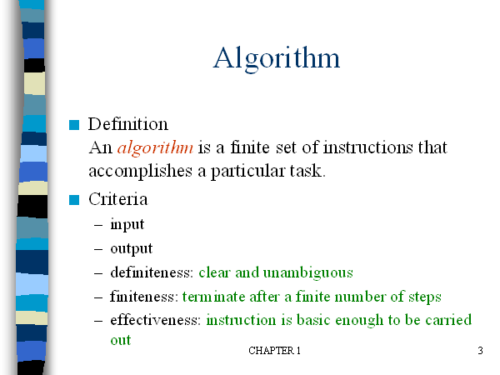
- Zero or more quantities should be externally supplied
-At least one quantity is produced
by a person using only pencil and paper

Slide 9
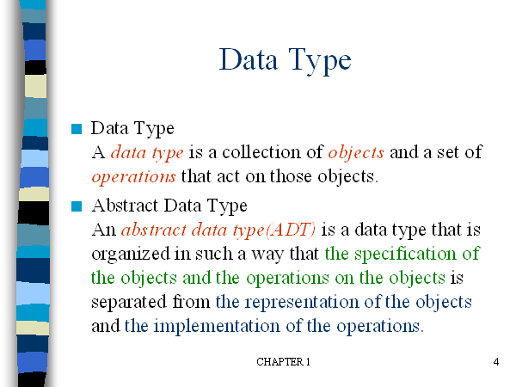

Slide 10
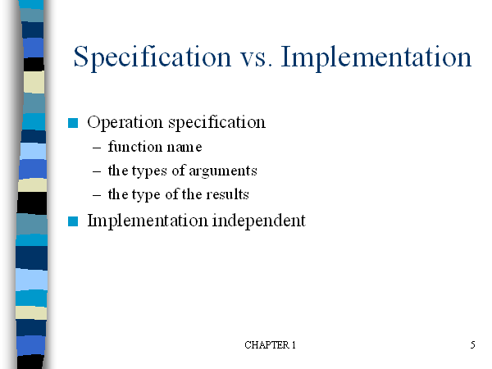

Slide 11
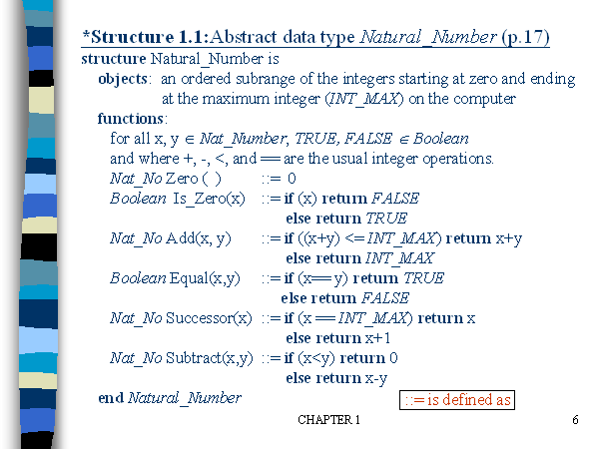

Slide 12
How to create programs
Seat of pants method: Write something down and then try to get it working.
The process of creating programs is split into five phases:
i) Requirements: Understand the information given (the inputs) and what results U R to produce (the outputs)
ii) Design: For each object there will be some basic opns to perform on it.
Write an algorithm which solves the problem.
iii) Analysis: Write more than one algorithm. Compare them and choose the best algorithm.
iv) Refinement and coding:
v) Verification: Consists of three distinct aspects:
Program proving: Prove that the program is correct for all possible combination of inputs.
Testing: The art of creating sample data upon which to run UR program.
Debugging: The process of correcting errors

Slide 13
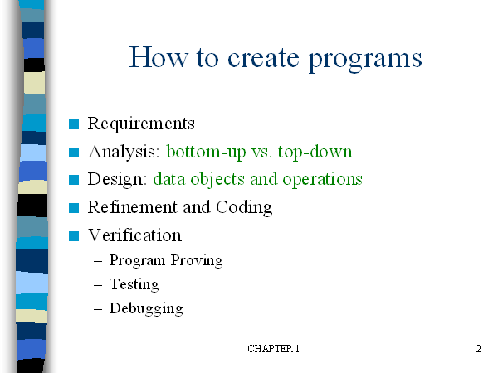

Slide 14
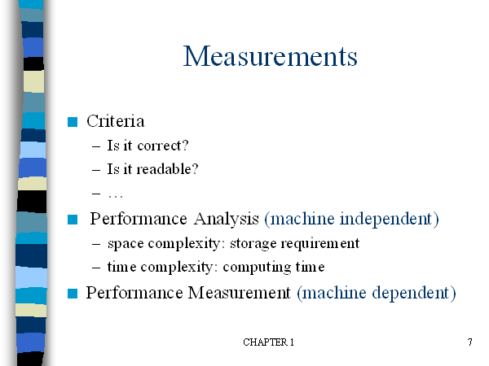

Slide 15
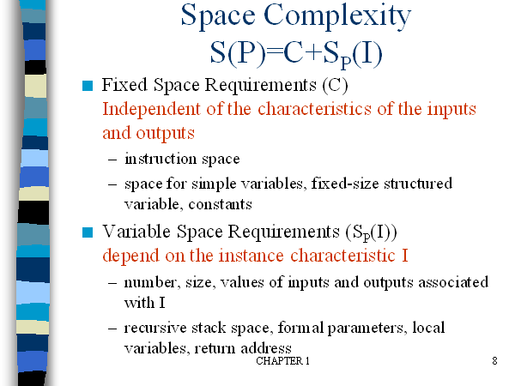

Slide 16
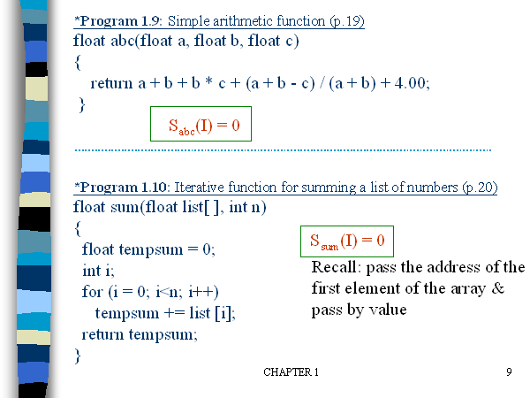

Slide 17
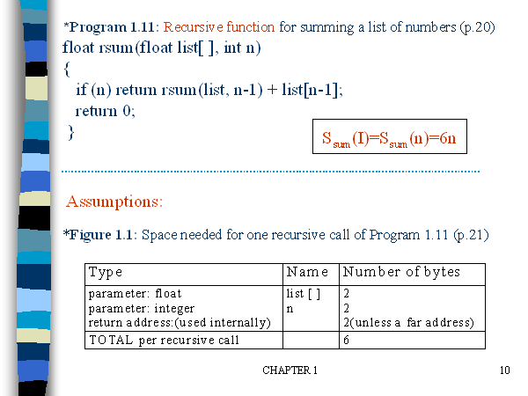

Slide 18
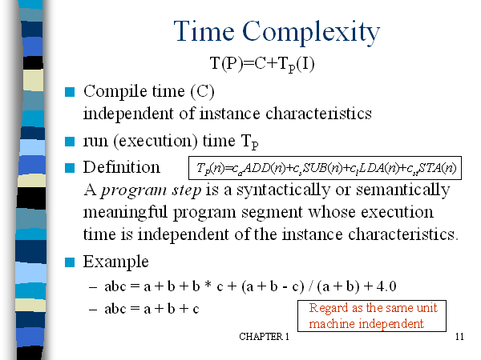

Slide 19
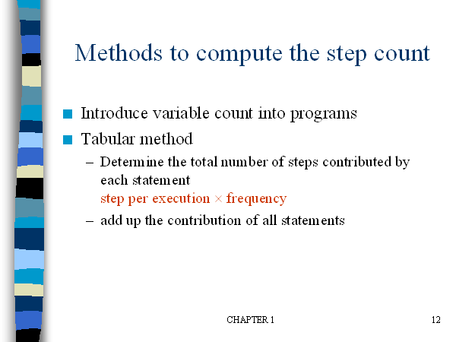

Slide 20
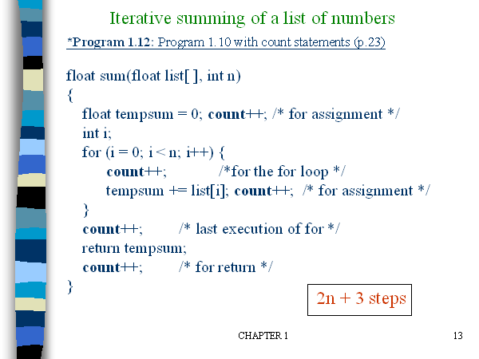

Slide 21
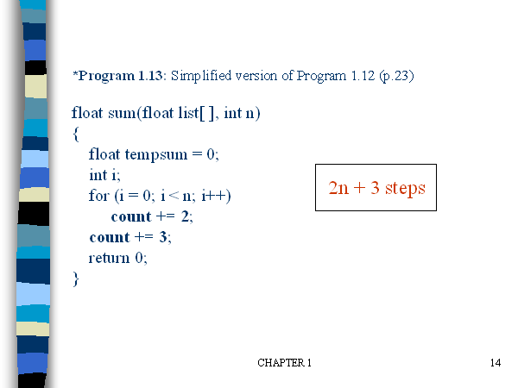

Slide 22
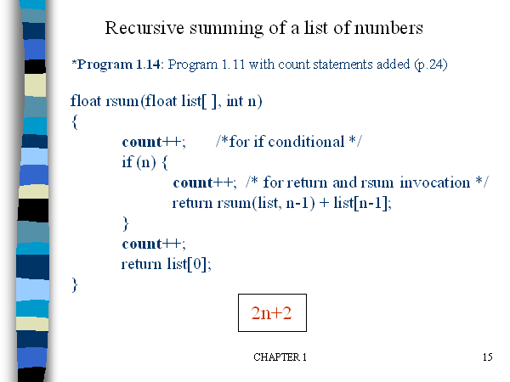

Slide 23
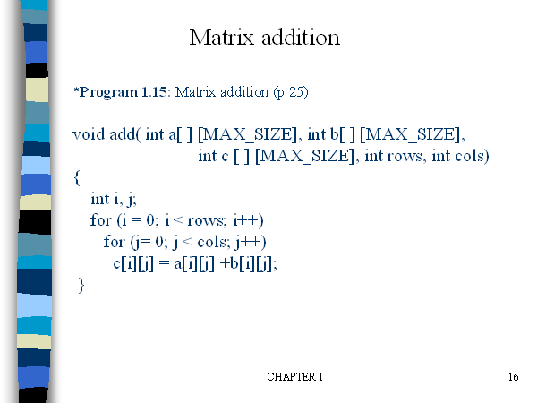

Slide 24
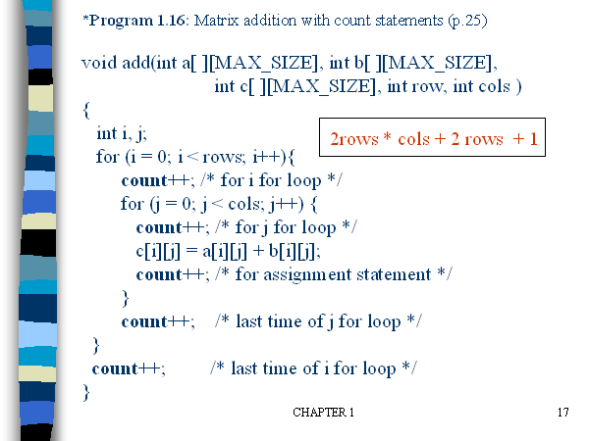

Slide 25
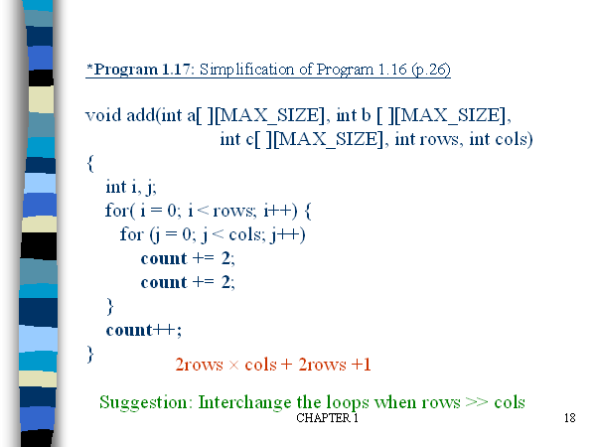

Slide 27
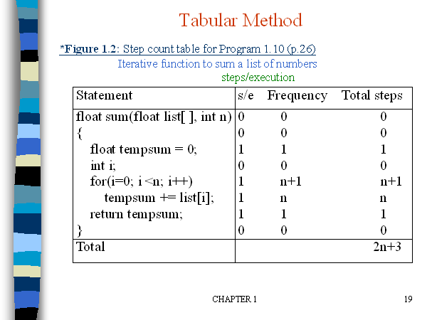

Slide 28
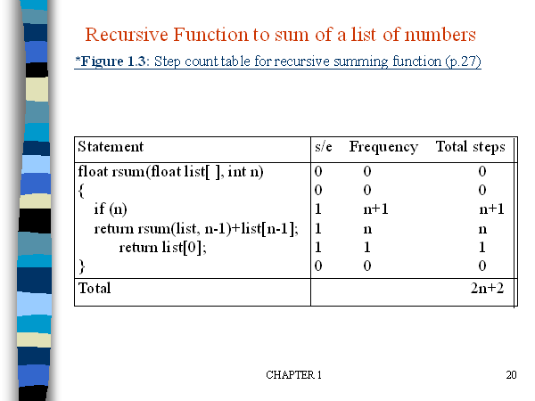

Slide 29
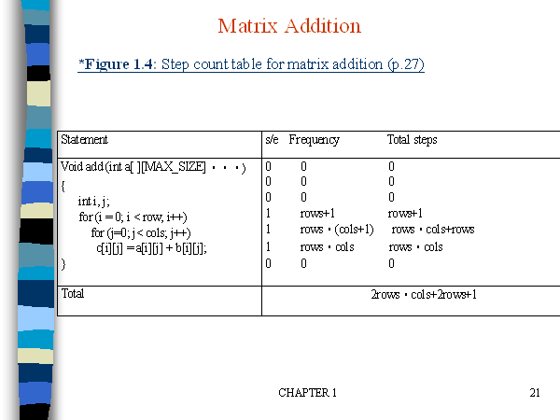

Slide 30
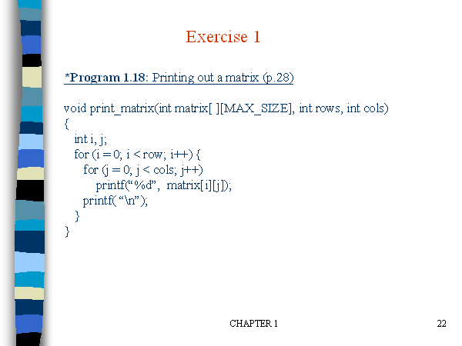

Slide 31
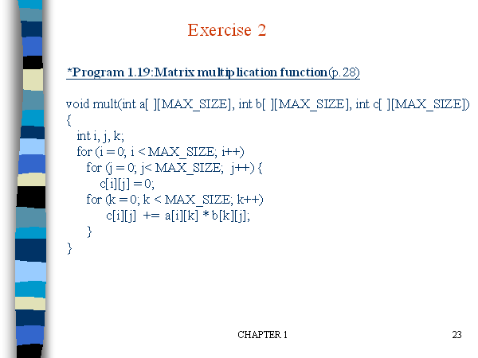

Slide 32
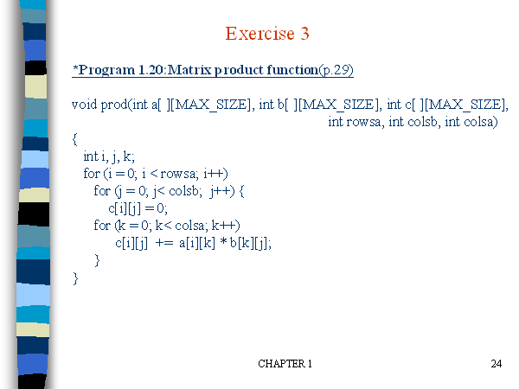

Slide 33
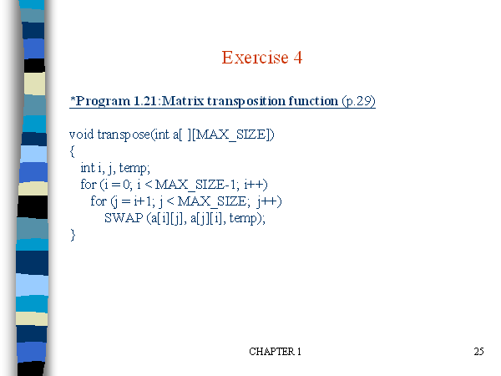

Slide 34
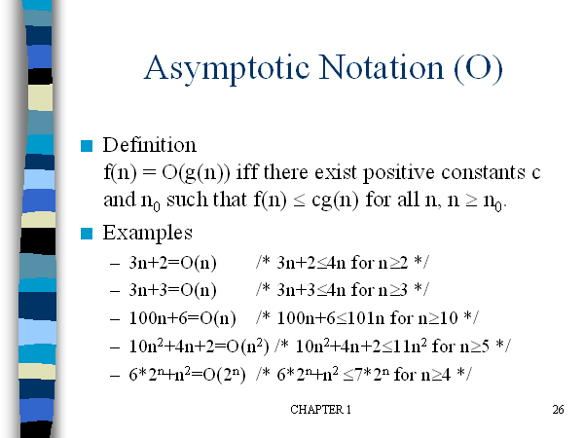

Slide 35
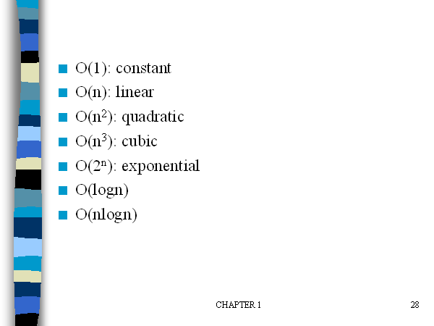

Slide 36
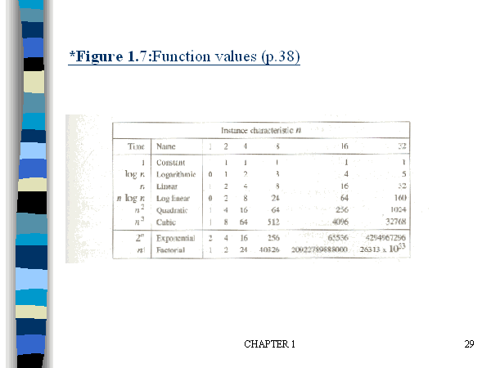

Slide 37
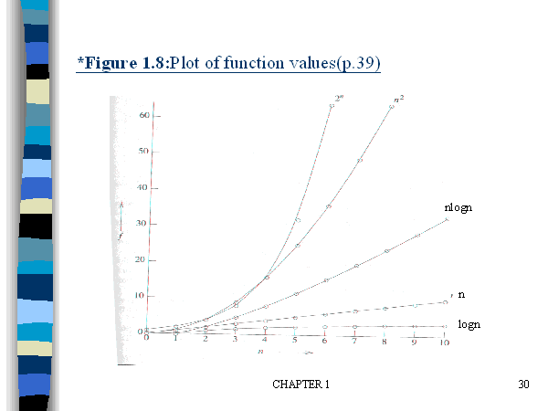

Slide 38
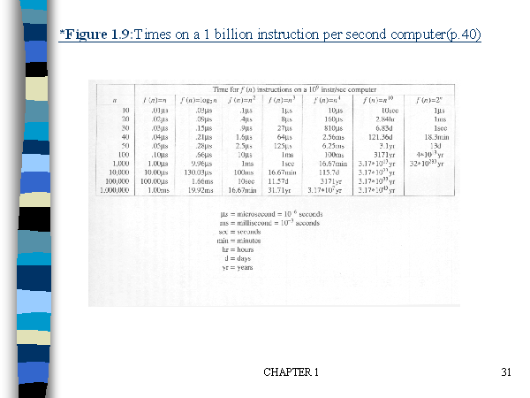

Slide 39
Divide and Conquer Method

Slide 40
1. Divide-Conquer Methods
2. Binary search
3. Merge sort
4. Quick sort

Slide 41
Divide-and-conquer approach
Divide-and-Conquer divides an instance of a problem into two or more smaller instances.
The smaller instances are usually instances of the original problem.
If solutions to the smaller instances can be obtained readily, the solution to the original instance can be obtained by combining these solutions.

Slide 42
If the smaller instances are still too large to be solved readily, they can be divided into still smaller instances.
This process of dividing the instances continues until they are so small that a solution is readily obtainable.

Slide 43
The divide-and-conquer approach is a top down Approach.
That is, the solution to a top-level instance of a problem is obtained by going down and obtaining solutions to smaller instances.
this is the method used by recursive routines.

Slide 44
Divide-and-conquer approach (Cont.)
The divide-and-conquer paradigm involves three steps at each level of the recursion: Divide the problem into a number of subproblems. Conquer the subproblems by solving them recursively. If the subproblem sizes are small enough, however, just solve the subproblems in a straightforward manner. Combine the solutions to the subproblems into the sloution for the original problem.

Slide 45
General Method-control abstraction
Algorithm DAndC(P)
{
If Small(P) then return S(P);
Else
{
Divide P into smaller instances P₁,P₂,….P_{K}. k>=1;
Apply DAndC to each of these subproblems;
Return Combine(DAndC(P₁),DAndC(P₂),…DAndC(P_{K});
}
}

Slide 46
T(n)= { g(n) n small
T(n₁)+T(n₂)+…+T(n_{k})+f(n) otherwise
Generally complexity for recurrences is given by
T(n)={ T(1) n=1
aT(n/b)+f(n) n>1
a,b are constants, n=b^{k}

Slide 47
Consider the case in which a=2 and b=2. Let T(1)=2 & f(n)=n.
We have,
T(n) = 2T(n/2)+n
= 2[2T(n/2/2)+n/2]+n
= [4T(n/4)+n]+n
= 4T(n/4)+2n
= 4[2T(n/4/2)+n/4]+2n
= 4[2T(n/8)+n/4]+2n
= 8T(n/8)+n+2n
= 8T(n/8)+3n

Slide 48
In general, we see that T(n)=2^iT(n/2^i )+in., for any log n >=I>=1.
→ T(n) =2^log n T(n/2^log n) + n log n
→Corresponding to the choice of i=log n
Thus, T(n) = 2^log n T(n/2^log n) + n log n
= n.T(n/n) + n log n
= n. T(1) + n log n
= 2n + n log n

Slide 49
Binary Search
The divide-and-conquer steps of Binary Search:
If x equals the middle item, quit.
Otherwise:
(1)Divide–the array into two subarrays about half as large. If x is smaller than the middle item, choose the left subarray. If x is larger than the middle item, choose the right subarray.
(2)Conquer-(solve) the subarray by determining whether x is in that subarray. Unless the subarray is sufficiently small, use recursion to do this.

Slide 50
(3)Combine-–the solution to the array from the solution to the subarray. No need for combining.

Slide 51
Recursive binary search algorithm
1. //ALGORITHM:Binsearch(a,i,l,x). 2. //given an array a(i,l) of elements in non-decreasing. 3.// order,1<=i<=l, determine whether x is present and 4. //if so, return j such that x=a[j], else return 0. 5. { 6. if(l=i) then { if(x=a[i] then return i; else return 0; }

Slide 52
else { // reduce P into smaller subproblems mid=[(i+l)/2] if(x=a[mid] then return mid else if(x<a[mid]) then return Binsearch(a,i,mid-1,x) else return Binsearch(a.mid+1,l,x) } }

Slide 53
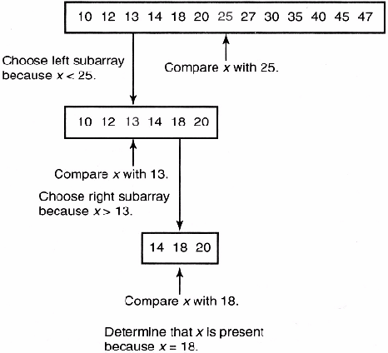
x=18

Slide 54
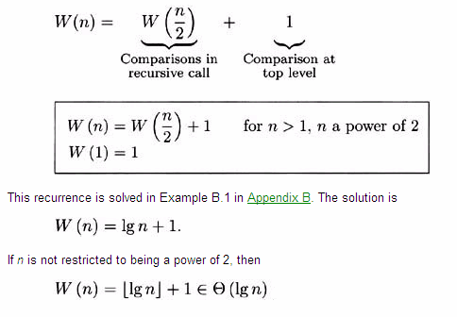
Analysis of Algorithm Worst-Case Time Complexity (Binary Search, Recursive)

Slide 55
Successful search
Best : O(1)
Average : O(log n)
Worst: O(log n)
Unsuccessful search : O(log n)

Slide 56
Example: Find the MAX and MIN
Obvious strategy (Needs 2n - 3 compares)
Find MAX (n - 1 compares)
Find MIN of the remaining elements (n - 2)
Nontrivial strategy
Split the array in half
Find the MAX and MIN of both halves
Compare the 2 MAXes and compare the 2 MINs to get overall MAX and MIN.
In this example, we only consider the number of comparisons and ignore all other operations.

Slide 57
Procedure mm(i, j: integer; var lo, hi: integer);
begin
if i = j
then begin lo := a[i]; hi := a[i] end
else if i = j-1
then begin if a[i] < a[j]
then begin lo := a [i]; hi := a[j] end
else begin lo := a [j]; hi := a[i] end
end
else begin
m := (i+j) div 2;
mm(i, m, min1, max1);
mm(m+1, j, min2, max2);
lo := MIN(min1, min2);
hi := MAX(max1, max2)
end
end.

Slide 58
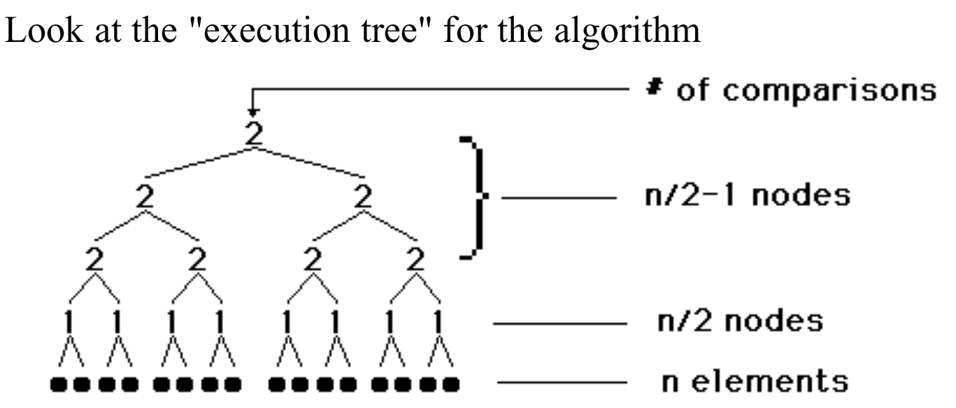
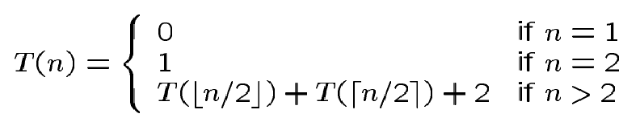
Analysis

Slide 59
Note
More accurately, it should be
Solving the above, we have T(n) = 3n/2 –2 if n is a power of 2.
This can be shown to be a lower bound.

Slide 60
Merge sort
The merge sort algorithm closely follows the divide-and-conquer paradigm. Intuitively, it operates as follows. Divide: Divide the n-element sequence to be sorted into two subsequences of n/2 elements each. Conquer: Sort the two subsequences recursively using merge sort. Combine: Merge the two sorted subsequences to produce the sorted answer.

Slide 61
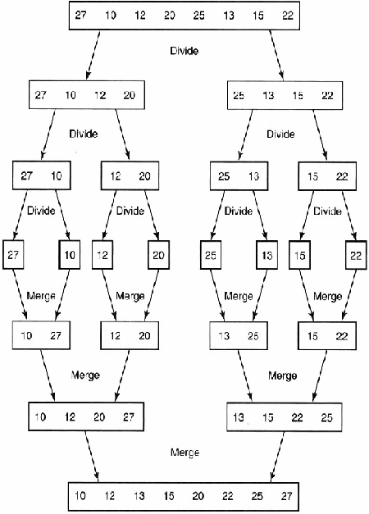

Slide 62
Merge sort using recursion
Input: An array A and indices low and high Output: An sorted array A MERGE-SORT(A, low, high) 1. if low< high 2. then mid = (low + high) / 2 3. MERGE-SORT(A, low, mid)
4. MERGE-SORT(A, mid+1, high) 5. MERGE(A, low, mid, high)

Slide 63
Algorithm: Merging 2 sorted subarrays using auxiliary storage.
Algorithm merge(low,mid,high)
//a[low:high] is a global array containing
//two sorted subsets in a[low:mid]
//and in a[mid+1:high].The goal is to merge these 2 sets into
//a single set residing in a[low:high].b[] is an auxiliary global array.

Slide 64
{
h=low; I=low; j=mid+1;
while ((h<=mid) and (j<=high)) do
{
if (a[h]<=a[j]) then
{
b[I]=a[h];
h = h+1;
}

Slide 65
else
{
b[I]= a[j];
j=j+1;
}
I=I+1;
}

Slide 66
if (h=mid) then
for k=j to high do
{
b[I]=a[k]; I=I+1;
}
else
for k=h to mid do
{ b[I]=a[k]; I=I+1; }
for k=low to high do a[k] = b[k];
}

Slide 67
Time Complexity –Merge Sort
T(n) =a n=1 a is constant
= 2T(n/2) + cn. n>1 c is constant In the same way: T(n/2) = 2T(n/4) + cn/2, so T(n) = 4T(n/4) + 2cn. Going in this way ...
T(n) = 2^{k}T(n/2^{k}) + kcn
= nT(1) + cnlog₂n = O(n log n).
Remember, as n=2^{k} k = log₂n!
The general case requires a bit more work, but it takes O(n log n) time anyway.

Slide 68
Introduction
Quicksort
Fastest known sorting algorithm in practice
Average case: O(N log N)
Worst case: O(N²)
But, the worst case seldom happens.

Slide 69
Quicksort
S
Divide step:
Pick any element (pivot) v in S
Partition S – {v} into two disjoint groups
S1 = {x ∈ S – {v} | x <= v}
S2 = {x ∈ S – {v} | x ≥ v}
Note: S1 and S2 may overlap. Why?
Conquer step: recursively sort S1 and S2
Combine step: the sorted S1 (by the time returned from recursion), followed by v, followed by the sorted S2 (i.e., nothing extra needs to be done)
v
v
S1
S2

Slide 70
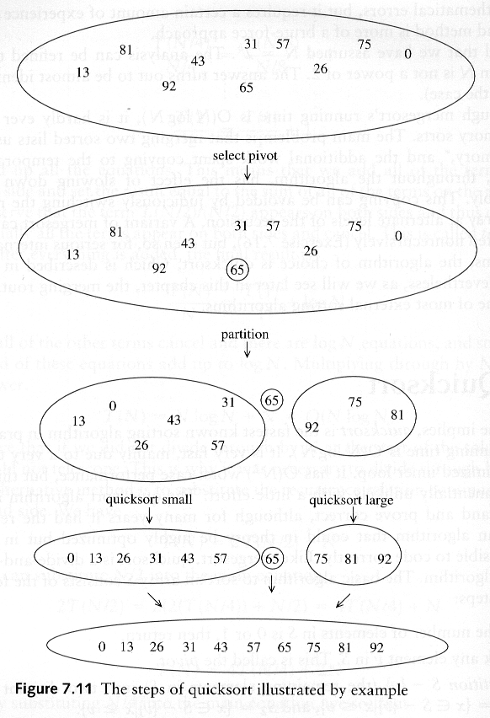
Example: Quicksort

Slide 71
Example: Quicksort...

Slide 72
Pseudocode
Input: an array A[p, r]
Quicksort (A, p, r) {
if (p < r) {
q = Partition (A, p, r) //q is the position of the pivot element
Quicksort (A, p, q-1)
Quicksort (A, q+1, r)
}
}

Slide 73
Partitioning
Partitioning
This is a key step of the quicksort algorithm
Goal: given the picked pivot, partition the remaining elements into two smaller sets
Many ways to implement how to partition:
Even the slightest deviations may cause surprisingly bad results.
We will learn an easy and efficient partitioning strategy here.
How to pick a pivot will be discussed later

Slide 74
Partitioning Strategy
Want to partition an array A[left .. right]
First, get the pivot element out of the way by swapping it with the last element. (Swap pivot and A[right])
Let i start at the first element and j start at the next-to-last element (i = left, j = right – 1)
swap
5
6
4
6
3
12
19
5
6
4
19
3
12
6
pivot
i
j

Slide 75
Partitioning Strategy
Want to have
A[p] <= pivot, for p < i
A[p] >= pivot, for p > j
When i < j
Move i right, skipping over elements smaller than the pivot
Move j left, skipping over elements greater than the pivot
When both i and j have stopped
A[i] >= pivot
A[j] <= pivot { A[i] and A[j] should now be swapped}
<= pivot
>= pivot
i
j
5
6
4
19
3
12
6
5
6
4
19
3
12
6
i
j
i
j

Slide 76
Partitioning Strategy
When i and j have stopped and i is to the left of j (thus legal)
Swap A[i] and A[j]
The large element is pushed to the right and the small element is pushed to the left
After swapping
A[i] <= pivot
A[j] >= pivot
Repeat the process until i and j cross
swap
5
6
4
19
3
12
6
5
3
4
19
6
12
6
i
j
i
j

Slide 77
Partitioning Strategy
5
3
4
19
6
12
6
When i and j have crossed
Swap A[i] and pivot
Result:
A[p] <= pivot, for p < i
A[p] >= pivot, for p > i
i
j
5
3
4
19
6
12
6
Swap!
i
j
5
3
4
6
6
12
19
break!
j
i

Slide 78
Conventional Matrix Multiplication
Brute-force algorithm
c₀₀ c₀₁ a₀₀ a₀₁ b₀₀ b₀₁
= *
c₁₀ c₁₁ a₁₀ a₁₁ b₁₀ b₁₁
a₀₀ * b₀₀ + a₀₁ * b₁₀ a₀₀ * b₀₁ + a₀₁ * b₁₁
=
a₁₀ * b₀₀ + a₁₁ * b₁₀ a₁₀ * b₀₁ + a₁₁ * b₁₁
8 multiplications
Efficiency class in general: Θ (n³)
4 additions

Slide 79
Strassen’s Matrix Multiplication
Strassen’s algorithm for two 2x2 matrices (1969):
c₀₀ c₀₁ a₀₀ a₀₁ b₀₀ b₀₁
= *
c₁₀ c₁₁ a₁₀ a₁₁ b₁₀ b₁₁
m₁ + m₄ - m₅ + m₇ m₃ + m₅
=
m₂ + m₄ m₁ + m₃ - m₂ + m₆
m₁ = (a₀₀ + a₁₁) * (b₀₀ + b₁₁)
m₂ = (a₁₀ + a₁₁) * b₀₀
m₃ = a₀₀ * (b₀₁ - b₁₁)
m₄ = a₁₁ * (b₁₀ - b₀₀)
m₅ = (a₀₀ + a₀₁) * b₁₁
m₆ = (a₁₀ - a₀₀) * (b₀₀ + b₀₁)
m₇ = (a₀₁ - a₁₁) * (b₁₀ + b₁₁)
7 multiplications
18 additions

Slide 80
Strassen’s Matrix Multiplication
Strassen observed [1969] that the product of two matrices can be computed in general as follows:
C₀₀ C₀₁ A₀₀ A₀₁ B₀₀ B₀₁
= *
C₁₀ C₁₁ A₁₀ A₁₁ B₁₀ B₁₁
M₁ + M₄ - M₅ + M₇ M₃ + M₅
=
M₂ + M₄ M₁ + M₃ - M₂ + M₆

Slide 81
Formulas for Strassen’s Algorithm
M₁ = (A₀₀ + A₁₁) ∗ (B₀₀ + B₁₁)
M₂ = (A₁₀ + A₁₁) ∗ B₀₀
M₃ = A₀₀ ∗ (B₀₁ - B₁₁)
M₄ = A₁₁ ∗ (B₁₀ - B₀₀)
M₅ = (A₀₀ + A₀₁) ∗ B₁₁
M₆ = (A₁₀ - A₀₀) ∗ (B₀₀ + B₀₁)
M₇ = (A₀₁ - A₁₁) ∗ (B₁₀ + B₁₁)

Slide 82
Analysis of Strassen’s Algorithm
If n is not a power of 2, matrices can be padded with zeros.
Number of multiplications:
M(n) = 7M(n/2), M(1) = 1
Solution: M(n) = 7^{log 2n} = n^{log 27} ≈ n^{2.807} vs. n³ of brute-force alg.
Algorithms with better asymptotic efficiency are known but they are even more complex and not used in practice.
What if we count both multiplications and additions?

Slide 83
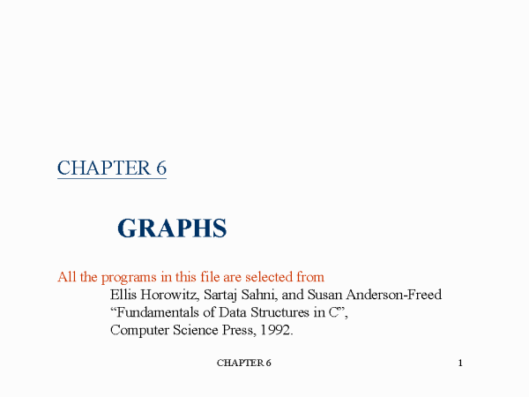

Slide 84
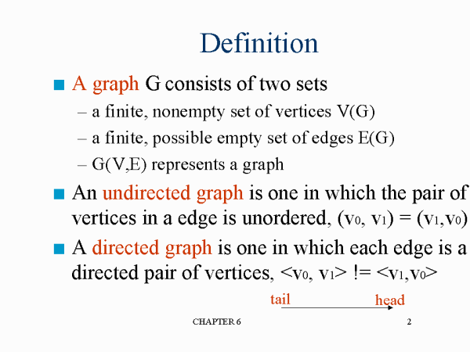

Slide 85
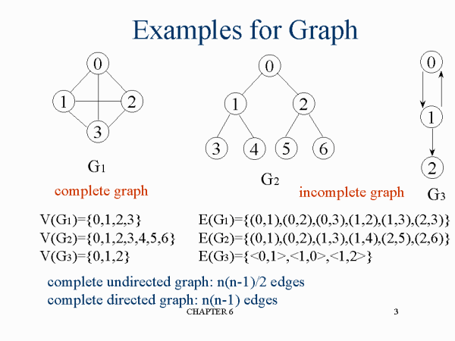

Slide 86
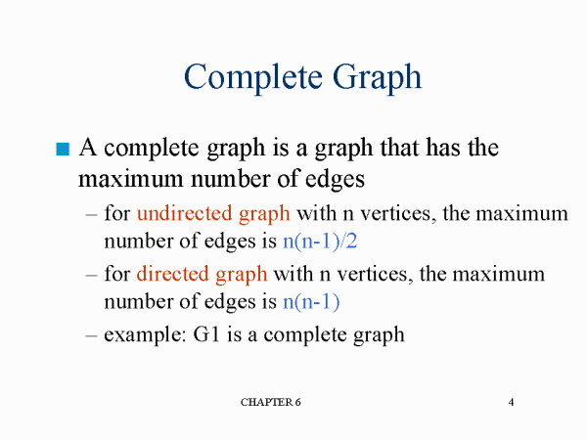

Slide 87
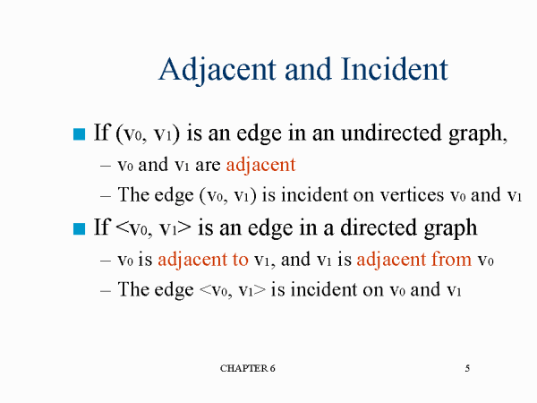

Slide 88
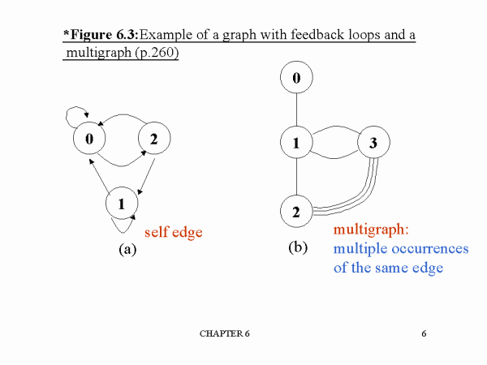

Slide 89
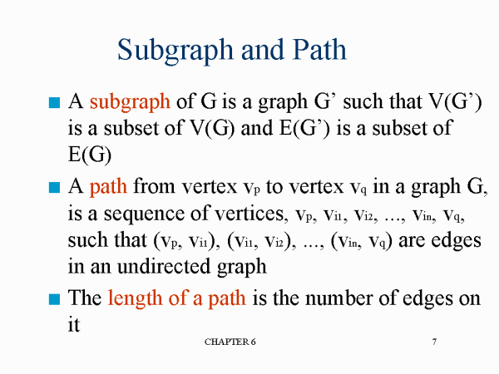

Slide 90
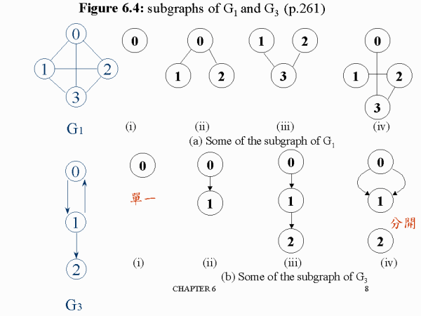

Slide 91
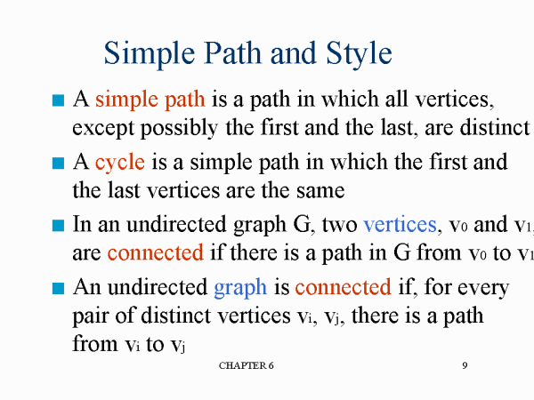

Slide 92
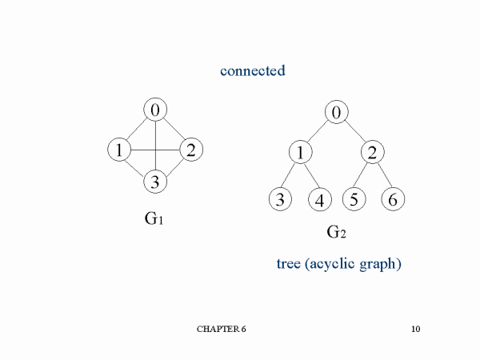

Slide 93
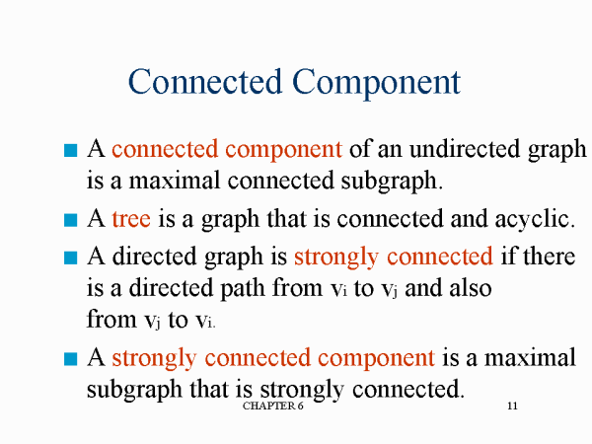

Slide 94
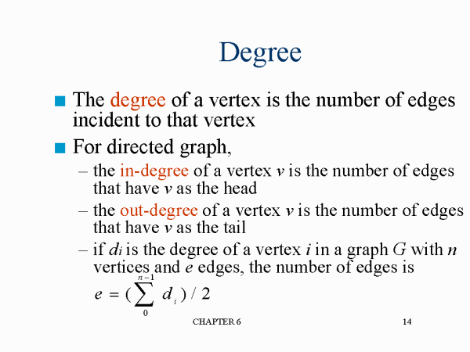

Slide 95
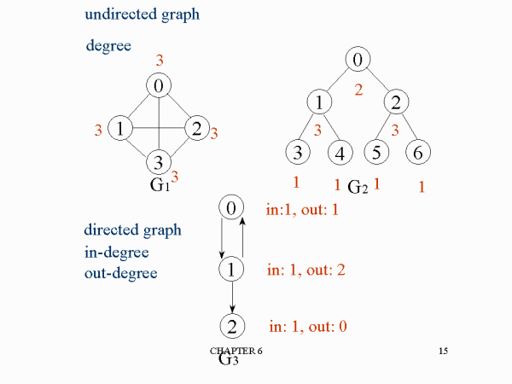

Slide 96
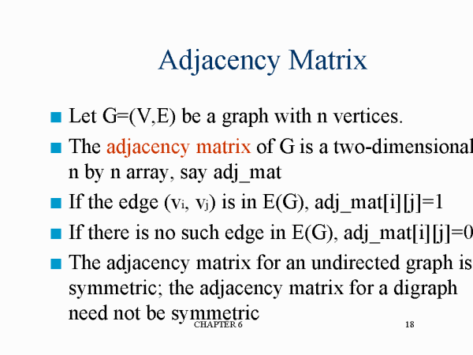

Slide 97
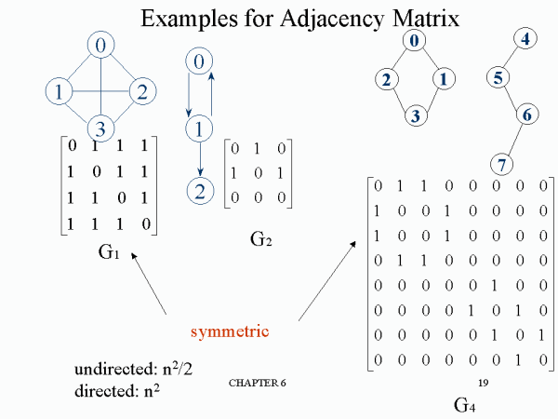

Slide 98


Slide 99


Slide 100
Greedy method

Slide 101
General Method
Feasible solution-constraints
Objective function- maximise or minimise
Optimal solution
Subset paradigm
Ordering paradigm

Slide 102
Control abstraction for greedy method- Subset paradigm
1. Algorithm Greedy (a,n)
2. //a[1:n] contain the ‘n’ inputs
3. {
4. solution =0;//Initialise the solution.
5. For i=1 to n do
6. {
7. x=select(a);
8. if(feasible(solution,x))then
9. solution=union(solution,x);
10. }
11. return solution;
12. }

Slide 103
Knapsack Problem
We are given n objects and knapsack or bag with capacity M
Object i has a weight W_{i} where i varies from 1 to n.
The problem is to fill the bag with the help of objects and the resulting profit has to be maximum.
Fraction x_{i}, 0<=x_{i}<=1 of object i is placed into the knapsack then profit p_{i}x_{i} is earned

Slide 104
Maximise ∑ p_{i}x_{i} 1≤ i ≤ n
Subject to ∑ w_{i}x_{i} ≤ m 1≤ i ≤ n
0≤ x_{i}≤ 1 1≤ i ≤ n

Slide 105
Example
Capacity=20
N=3, M=20
Wi=18, 15, 10
Pi=25, 24, 15

Slide 106
X₁ X₂ X₃ W_{i}X_{i} P_{i}X_{i}
½ 1/3 ¼
1 2/15 0
0 2/3 1
0 1 ½

Slide 107
X₁ X₂ X₃ W_{i}X_{i} P_{i}X_{i}
½ 1/3 ¼ (1/2)*18+(1/3) *15+(1/4)*10 =16.5 (1/2)*25+(1/3) *24+(1/4)*15 = 24.25
1 2/15 0 (1)*18+(2/15) *15+(0)*10 = 20 (1)*25+(2/15) *24+(0)*15 = 28.2
0 2/3 1 (0)*18+(2/3) *15+(1)*10 = 20 (0)*25+(2/3) *24+(1)*15 = 31
0 1 ½ (0)*18+(1) *15+(1/2)*10 = 20 (0)*25+(1) *24+(1/2)*15 = 31.5

Slide 108
Order by profit
Weight profit wt reqd/wt
X₁ 18 25
X₂ 15 24
X₃ 10 15

Slide 109
Weight profit wt reqd/wt
X₁ 18 25 1.0
X₂ 15 24 (2/15)0.133
X₃ 10 15 0
∑P_{i}X_{i} = 1*25+0.133*24
= 28.192

Slide 110
Weight profit pi/wi wt reqd/wt
X ₂ 15 24 1.6 1
X ₃ 10 15 1.5 (5/10) 0.5
X₁ 18 25 1.38 0
∑ P_{i}X_{i} = 1*24+0.5*15
=31.5 (optimal solution)

Slide 111
Order by weight(capacity)
Weight profit wt reqd/wt
X ₃ 10 15
X₂ 15 24
X₁ 18 25

Slide 112
Weight profit wt reqd/wt
X₃ 10 15 1.0
X₂ 15 24 (10/15)0.67
X₁ 18 25 0
∑ P_{i}X_{i} = 1*15+0.67*24
=31

Slide 113
Order by ratio of accumulated profit to capacity(P_{i} /W_{i} )
Weight profit pi/wi
X ₂ 15 24 1.6
X ₃ 10 15 1.5
X₁ 18 25 1.38

Slide 114
Algorithm
1.Algorityhm Greedy knapsack (m,n)
2//P[1:n] and the w[1:n]contain the profit
3.// & weight res’.of the n object ordered.
4.//such that p[i]/w[i] >=p[i+1]/W[i+1]
5.//m is the Knapsack size and x[1:n] is the solution vertex.
6.{
7.for i=1 to n do x[i]=0.0;
8.U=m;
9.For i=1 to n do
10.{
11.if (w[i]>U)then break;
13.x[i]=1.0;U=U-w[i]
14.}
15.if(i<=n)then x[i]=U/w[i];
16.}

Slide 115


Slide 117


Slide 118


Slide 119


Slide 120


Slide 121


Slide 122


Slide 123


Slide 124


Slide 125


Slide 126


Slide 127


Slide 128


Slide 129


Slide 130


Slide 131


Slide 132


Slide 133


Slide 134


Slide 135


Slide 136
Optimal Storage on Tapes
Optimal Storage on Tapes is one of the application of the Greedy Method.
The objective is to find the optimal retrieval time for accessing programs that are stored on tape.

Slide 137
Description
There are n programs that are to be stored on a computer tape of length L.
Associated with each program i is a length l;
Clearly, all programs can be stored on the tape if and only if the sum of the lengths of the programs is at most L.
We shall assume that whenever a program is to be retrieved from this tape, the tape is initially positioned at the front.

Slide 138

Description
Hence' if the programs are stored in the order I=i₁, i_{2’} i_{3 ….} i_{n} the time t_{j} needed to retrieve program i_{j} is proportional to l_{ik} .
If all programs are retrieved equally often then the expected or mean retrieval time (MRT) is

Slide 139

Example

Slide 140
Method
The greedy method simply requires us to store the programs in non-decreasing order of their lengths.
This ordering (sorting) can be carried out in O(n log n) time using an efficient sorting algorithm

Slide 141

Algorithm for multiple tapes
Note: The programs are assumed to be in increasing order of their lengths

Slide 142
The 2-way merging problem
# of comparisons required for the linear 2-way merge algorithm is m₁+ m₂ -1 where m₁ and m₂ are the lengths of the two sorted lists respectively.
2-way merging example
2 3 5 6
1 4 7 8
The problem: There are n sorted lists, each of length m_{i}. What is the optimal sequence of merging process to merge these n lists into one sorted list ?

Slide 143

Extended binary trees
An extended binary tree representing a 2-way merge

Slide 144


An example of 2-way merging
Example: 6 sorted lists with lengths 2, 3, 5, 7, 11 and 13.

Slide 145



Time complexity for generating an optimal extended binary tree:O(n log n)

Slide 146
Huffman codes
In telecommunication, how do we represent a set of messages, each with an access frequency, by a sequence of 0’s and 1’s?
To minimize the transmission and decoding costs, we may use short strings to represent more frequently used messages.
This problem can by solved by using an extended binary tree which is used in the 2-way merging problem.

Slide 147

An example of Huffman algorithm
Symbols: A, B, C, D, E, F, G
freq. : 2, 3, 5, 8, 13, 15, 18
Huffman codes:
A: 10100 B: 10101 C: 1011
D: 100 E: 00 F: 01
G: 11
A Huffman code Tree

Slide 148
Lecture 5: Backtracking
Depth-First Search N-Queens Problem Hamiltonian Circuits

Slide 149
Backtracking
Backtracking is closely related to the brute-force problem-solving method in which the solution space is scanned, but with the additional condition that only the possible candidate solutions are considered.
What is meant by possible solutions and how these are differentiated from the impossible ones are issues specific to the problem being solved.
http://www.devarticles.com/c/a/Development-Cycles/The-Backtracking-Algorithm-Technique/

Slide 150
Backtracking
function backtrack(current depth)
if solution is valid
return / print the solution
else
for each element from A[ ] source array
let X[current depth] ß element
if possible candidate (current depth + 1)
backtrack(current depth + 1)
end if
end for
end if
end function
http://www.devarticles.com/c/a/Development-Cycles/The-Backtracking-Algorithm-Technique/

Slide 151
Depth-First Tree Search
procedure depth_first_tree_search(v:node)
u : node;
begin
for each child u of v loop
depth_first_tree_search(u);
end loop;
end depth_first_tree_search;
1
2
11
3
10
12
13
4
14
15
18
5
9
16
17
6
8
7

Slide 152
Depth-First Tree Search
We will use the convention of choosing nodes in a left-to-right order (or alphabetical if labeled).
1
2
11
3
10
12
13
4
14
15
18
5
9
16
17
6
8
7

Slide 153
Depth-First Search
Depth-First traversal is a type of backtracking in a graph. If we use an alpha-numeric order for node traversal we can define a unique ordering of the nodes encountered in a connected graph.
A
A B
A C
A D
A E
B A
B G
C A
C F
D A
D F
D H
E A
E G
E H
F C
F D
F H
F I
G B
G E
G H
H D
H E
H F
H G
H I
I F
I H
Starting at node A we can traverse every other node in a depth-first order, making sure that we do not enter any node more than once.
C
B
D
E
F
G
H
I
A B G E H D F C I
We move forward from A to C and then
we have to backtrack to F and move forward to I.
Edge list representation

Slide 154
Backtracking Technique
Backtracking is used to solve problems in which a feasible solution is needed rather than an optimal one, such as the solution to a maze or an arrangement of squares in the 15-puzzle. Backtracking problems are typically a sequence of items (or objects) chosen from a set of alternatives that satisfy some criterion.
1
2
3
4
6
10
14
15
5
7
8
9
6
11
12
13
10
14
15

Slide 155
Backtracking Implementation
Backtracking is a modified depth-first search of the solution-space tree. In the case of the maze the start location is the root of a tree, that branches at each point in the maze where there is a choice of direction.

Slide 156


N-Queens Problem
The problem of placing N queens on an NxN chessboard in such a way that no two of them are "attacking" each other, is a classic problem used to demonstrate the backtracking method.
A simple brute-force method would be to try placing the first queens on the first square, followed by the second queen on the first available square, scanning the chessboard in a row-column manner.
A more efficient backtracking approach is to note that each queen must be in its own column and row. This reduces the search from (N²)! to N!.

Slide 157
Sample: N Queens Backtracking Algorithm
by Antal
#include <stdio.h>
#include <math.h>
#include <conio.h>
int n, x[30];
int solution(int k)
{
return k==n;
}
void print(int k)
{
for (int i=1;i<k+1;i++)
printf("%d ",x[i]);
printf("\n");
}
int possible(int k)
{
for (int i=1;i<k;i++)
if (x[i]==x[k] || abs(x[i]-x[k])==k-i)
return 0;
return 1;
}
void back(int k)
{
if (solution(k))
print(k);
else
for (x[k+1]=1; x[k+1]<=n; x[k+1]++)
if (possible(k+1))
back(k+1);
}
void main()
{
char ch;
printf("Enter the size of NxN chessboard: ");
scanf("%d",&n);
printf("\nThe solution: ");
back(0);
}
Can you see how this code checks for "attacking" queens?

Slide 158
Hamiltonian Cycles
Let G = (V, E) be a connected graph with n vertices. A Hamiltonian cycle (suggested by William Hamilton) is a round-trip path along n edges of G that visits every vertex once and returns to its starting position.
In other words, if the vertices of G are visited in the order v1, v2, . . . . . , vn+1, then the edges (vi, vi+1) are in E, 1 < i < n, and the vi are distinct expect for v1 and vn+1, which are equal.

Slide 159
Hamiltonian Cycles
The graph G1 contains the Hamiltonian cycle 1, 2, 8, 7, 6,5, 4, 3, 1.
x[1] = 1, x[2] = 2, x[3] = 8, x[4] = 7, X[5] = 6,
x[6] = 5, x[7] = 4, x[8] = 3, x[9] = 1
The graph G2 contains no Hamiltonian cycle.

Slide 160
Hamiltonian Cycles
The backtracking solution vector (x1,.,.xn) is defined so that Xi represents the ith visited vertex of the proposed cycle. Now all we need do is determine how to compute the set of possible vertices for xk if x1,..xk-1 have already been chosen. If k = 1, then x1 can be any of the n vertices.
To avoid printing the same cycle n times, we require that x1 =1. If 1<k <n, then X1 can be any vertex v that is distinct from x1,X2,…, xk-1 and v is connected by an edge to xk-1

Slide 161
Hamiltonian Cycles
The vertex xn can only be the one remaining vertex and it must be connected to both xn-1 and x1.
We begin by presenting function NextValue(k) (Algorithm7.9), which determines a possible next vertex for the proposed cycle.
Using NextValue we can particularize the recursive backtracking schema to find all Hamiltonian cycles (Algorithm 7.10).

Slide 162
Hamiltonian Cycles
This algorithm is started by first initializing the adjacency matrix G[l:n, 1:n], then setting x[2:n] to zero and x[l] to 1, and then executing Hamiltonian(2)

Slide 165
7.4 GRAPH COLORING
Let G be a graph and m be a given positive integer. We want to discover whether the nodes of G can be colored in such a way that no two adjacent nodes have the same color yet only m colors are used. This is termed the m-colorability decision problem.
Note that if d is the degree of the given graph, then it can be colored with d + 1 colors.

Slide 166
7.4 GRAPH COLORING

Slide 167
7.4 GRAPH COLORING
The m- colorability optimization problem asks for the smallest integer m for which the graph G can be colored. This integer is referred to as the Chromatic number of the graph.
For example, the graph of Figure 7.11 can be colored with three colors 1,2,and 3. The color of each node is indicated next to it. It can also be seen that three colors are needed to color this graph and hence this graph's chromatic number is 3.

Slide 168
7.4 GRAPH COLORING
A graph is said to be planar iff it can be drawn in a plane in such a way that no two edges cross each other.
A famous special case of the m-colorability decision problem is the 4-color problem for planar graphs. This problem asks the following question: given any map, can the regions be colored in such a way that no two adjacent regions have the same color yet only four colors are needed?

Slide 170
7.4 GRAPH COLORING
This turns out to be a problem for which
Graphs are very useful, because a map can easily be transformed into a graph.
Each region of the map becomes a node, and if two regions are adjacent, then the corresponding nodes are joined by an edge. Figure 7.12 shows a map with five regions and its corresponding graph. This map requires four colors. For many years, it was known that five colors were sufficient to color any map, but no map that required more than four colors had ever been found.

Slide 172
7.4 GRAPH COLORING
After several hundred years, this problem was solved by a group of Mathematicians with the help of a computer. They showed that in fact four colors are sufficient. In this section we consider not only graphs that are produced from maps but all graphs. We are interested in determining all the different ways in which a given graph can be colored using at most m colors.

Slide 173
7.4 GRAPH COLORING
Suppose we represent a graph by its adjacency matrix G[1 : n, 1 : n], where G[i, j] = 1 if (i,j) is an edge of G, and G[i,j] = 0 otherwise. The colors are represented by the integers 1,2,…,m. and the solutions are given by the n-tuple (x1,... ,xn), where xi is the color of node i. Using the recursive Backtracking formulation as given in Algorithm 7.1, the resulting algorithm is mColoring (Algorithm 7.7).

Slide 174
7.4 GRAPH COLORING
The underlying state space tree used is a
tree of degree m and height n + 1. Each node at level i has m children corresponding to the m possible assignments to xi, 1< i < n. Nodes at 3 and m = 3.
Function mColoring is begun by first assigning the graph to its adjacency matrix, setting the array x[] to zero, and then invoking the statement mColoring(l);.

Slide 175
7.4 GRAPH COLORING
Notice the similarity between this algorithm and the general form of the recursive backtracking schema of Algorithm 7.1. Function NextValue(Algorithm 7.8) produces the possible colors for xk after xi through Xk-1 have been defined. The main loop of mColoring repeatedly picks an element from the set of possibilities assigns it to xk, and then calls mColoring recursively.

Slide 178
7.4 GRAPH COLORING
For instance, Figure7.14 shows a simple graph containing four nodes. Below that is the tree that is generated by mColoring.
Each path to a leaf represents a coloring using at most three colors.
Note that only 12 solutions exist with exactly three colors.
In this tree, after choosing x1 = 2 and X2 = 1, the possible choices for x3 are 2 and 3. After choosing x1 = 2,X2 = 1, and X3 = 2, possible values for x4 are 1 and 3. and so on.

Slide 180
7.4 GRAPH COLORING
1 Algorithm mColoring(A;)
2 // This algorithm was formed using the recursive backtracking
3 // schema. The graph is represented by its Boolean adjacency
4 // matrix G[l:n, 1:n]. All assignments of 1,2,m..t.o, the
5 // vertices of the graph such that adjacent vertices are
6 // assigned distinct integers are printed, k is the index
7 // of the next vertex to color.
8 {
9 repeat
10 {//Generate all legal assignments for x[k].
11 NextValue(k);// Assign to x[k]a legal color.
12 if (x[k]= 0) then return;// No new color possible
13 if (k = n) then // At most m colors have been
14 // used to color the n vertices.
15 write (x[l :n]); 16 else mColoring(A; + 1);
17 }until(false);
18 }

Slide 181
7.4 GRAPH COLORING

Slide 182
1 AlgorithmNextValue(k)
2 // x[l],…x[k-1] have been assigned integer values in
3 // the range [l,m] such that adjacent vertices have distinct
4 // integers. A value for x[k] is determined in the range
5 // [0,m]. x[k] is assigned the next highest numbered color
6 // while maintaining distinctness from the adjacent vertices
7 // of vertex k. If no such color exists, then x[k] is 0.
8 {
9 repeat
10 {
11 x[k] :=(x[k]+ 1) mod(m+ 1);// Next highest color.
12 if (x[k]= 0) then return;// All colors have been used.
13 for j :=1to n do
14 { // Check if this color is
15 // distinct from adjacent colors.
16 if ((G[k,j] != 0) and (x[k]= x[j]))
17 // If (k,j) is and edge and if adj.
18 // vertices have the same color.
19 then break;
20 }
21 if (j = n + 1) then return;// New color found
22 }until(false); // Otherwise try to find another color.
23 }

Slide 183
Chapter 7 BACKTRACKING
7.1 THE GENERALMETHOD
In many applications of the backtrack method, the desired solution is expressiblaes an n-tuple (xi,.,.x.n), where the %i fire chosen from some finite set Sj. Often the problem to be solved calls for finding one vector that maximizes (or minimizes or satisfies) a criterion function P(x1,x2, x3, … xn)- Sometime its seeks all vectors that satisfy P. For examples, sorting the array of integers in a[l: n] is a problem whose solution is expressible by an n tuple, where xi is the index in a of the ith smallest element. The criterion
Function P is the inequality a[xj\\ < a[xi+\\]for 1<i <n.
The set Sj is finite and includes the integers 1through n. Though sorting is not usually one of the problems solved by backtracking it, is one example of a familiar problem
Whose solution can be formulated as an n-tuple. In this chapterwe study a
collectionof problemswhosesolutionsarebestdoneusingbacktracking.
Supposeml is the sizeof set Si.Then therearem = m\\m2 \342\226\240\342\226\240\342\226\240mn ntuplesthat
arepossiblceandidatesfor satisfying the functionP.The brute
forceapproachwould be toform all thesen-tuplese,valuateeachonewith
P, and save thosewhich yield the optimum.Thebacktrackalgorithmhas
as its virtue the ability to yield the sameanswer with far fewer than m trials.Itsbasicideais to build up the solutionvectoronecomponent at a
timeand to usemodifiedcriterionfunctionsPi{x\\,,.x..i)(sometimecsalled

Slide 184
Chapter 7 BACKTRACKING
7.1 THE GENERALMETHOD
In the search for fundamental principles of algorithm design, backtracking represents one of the most general techniques.
Many problems which deal with searching for a set of solutions or which ask for an optimal solution satisfying some constraints can be solved using the backtracking formulation.
The name backtrack was first coined by D.H.Lehmer in the 1950s. Early workers who studied the process were R.

